Slide 1
Police Response to Resistance
Presenter:
Apurva Godghase

Slide 2
Agenda
Introduction
Descriptive and Predictive Analysis
Dataset Walk though
Preprocessing activities
Models built
Summary of Findings
Managerial Implications

Slide 3
Introduction
Analyze the extent of law enforcement.
Dallas Police Department’s Data is the source of our study
Intent is to study police-citizen interaction and chalk out behavioral patterns or traits of citizens that are involved in the interaction
Analysis could be an action plan moving forward

Slide 4
Descriptive and Predictive Analysis
Descriptive Questions:
Which is the region and time where most of the interactions happen?
Is any specific race of citizen is observed most in all interactions?
Is any specific gender observed in interactions?
Predictive Questions:
What is the trend of citizen getting arrested in year 2015?
What are the number of incidences occurring in a stipulated time period in the following year?
What are the most risk prone areas of the city?
Predicting the outcome in terms of injury of the interaction between both citizen and the involved police office ?
Predicting the correlation between citizen arrests and various seasons and specific time of year ?

Slide 5
Dataset walk through
Variable | Description | Status
ID | Id as per the data set-- | Reject
FILE NUM | File of the incident captured | Reject
OCCURRED_DT | Date when the incident happened | Input
OCCURRED_TM | Time when the incident happened | Input
CURRENT_BADGE_NO | Current Badge Number | Reject
OffSex | Officer’s sex | Input
OffRace | Officer’s race | Input
HIRE_DT | Date when officer was hired | Input
OFF_INJURED | Was the officer injured or not | Input
OffCondType | Condition if the officer was injured | Input
OFF_HOSPITAL | If the officer was admitted to hospital or not | Input
SERVICE_TYPE | Type of service provided by the police department | Input
UOFNum | UOF Number | Reject
ForceType | How did the police officer applied the force (held, grabbed | Input
ForceEffective | Conditional variable stating if the applied force was effective | Input
UOF_REASON | Reason of UOF | Input
Cycles_Num | Number of interactions the police has with the | Input
CitNum | Unique identifier for the citizen | Reject
CitRace | Race of the citizen | Input
CitSex | Sex of the citizen | Input
CIT_INJURED | Whether the citizen was injured or not | Input
CitCondType | What kind of injuries citizen had | Input
CIT_ARRESTED | Whether the citizen was arrested or not | Input
CIT_INFL_ASSMT | Initial assessment of the citizen at the time of the first | Input
CitChargeType | What kind of charges were imposed on the citizen | Input
ARC_Street | Street address of the incidence | Input
RA | Area code of the incidence | Input
BEAT | Beat Code of the incidence | Input
SECTOR | Sector number of the incidence | Input
DIVISION | Division of the incidence | Input
DIST_NAME | District Name of the incidence | Input
GeoLocation | Geo Location of the incidence | Input
Latitude | Missing | Reject
Latitude | Missing | Reject
Time related attributes –
Occurred time, Occurrence date, Officer Hire date
Officer related attributes –
Badge number, Officer Sex, Officer Race,
Officer Injury, Officer Condition,
Officer in hospital, Service Type
Citizen related attributes –
Citizen Number, Citizen Race, Citizen Sex,
Citizen Injury, Citizen Condition Type,
Citizen Arrest, Citizen Assessment type,
Citizen charge type
Location related attributes-
RA, Beat, Sector, Division, District, Geolocation
Interaction Related attributes-
ID, File number, Force type, Force Effective,
UOF Number

Slide 6
Preprocessing Activities
Date format changes
Removing blank columns
Timestamp
Consistency
Most probable value
Binning
Dummy Coding

Slide 7
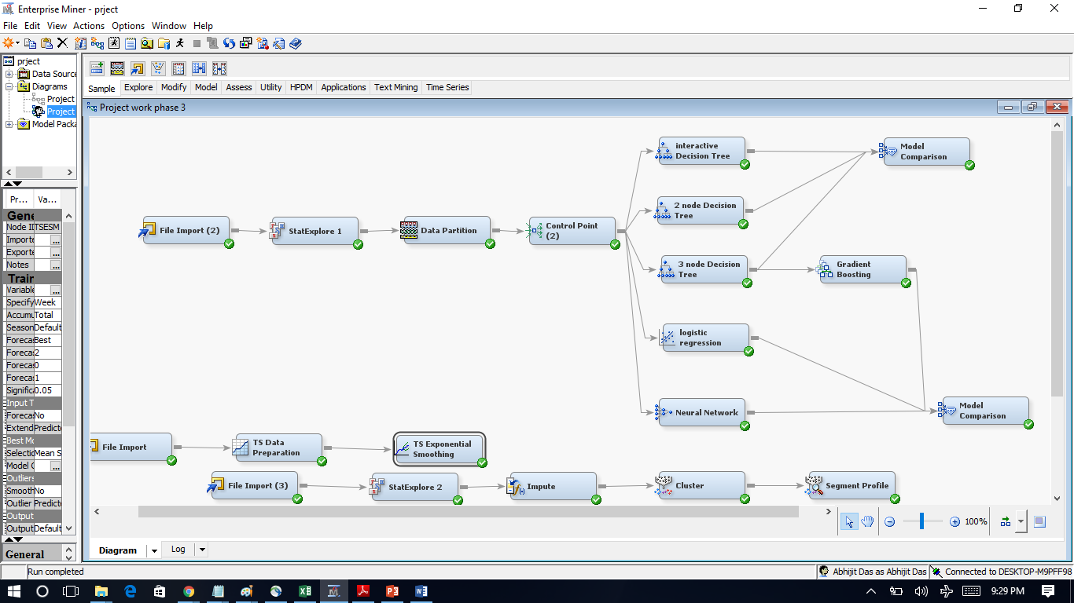
Overview of Models

Slide 8
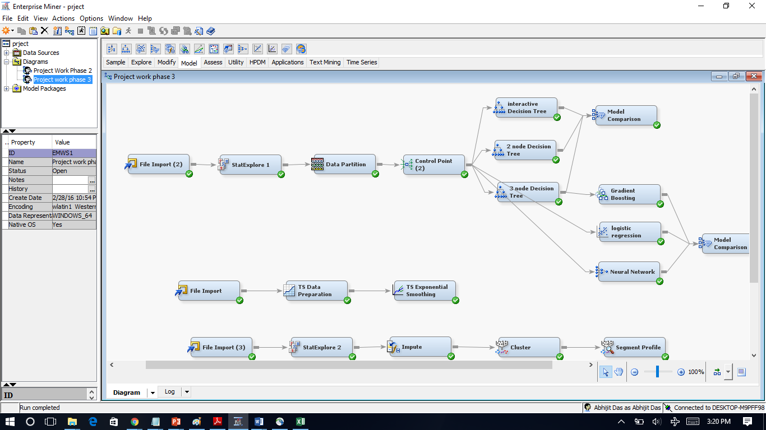
Contd.
Data Preprocessing
Data Partitioning
Control Point for Further analysis

Slide 9
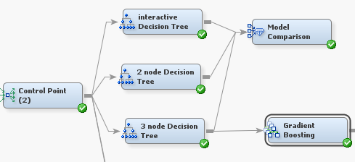
Contd.
Interactive Decision Tree
2 Node Decision Tree
3 Node Decision Tree
Model Comparison
Gradient Boosting

Slide 10
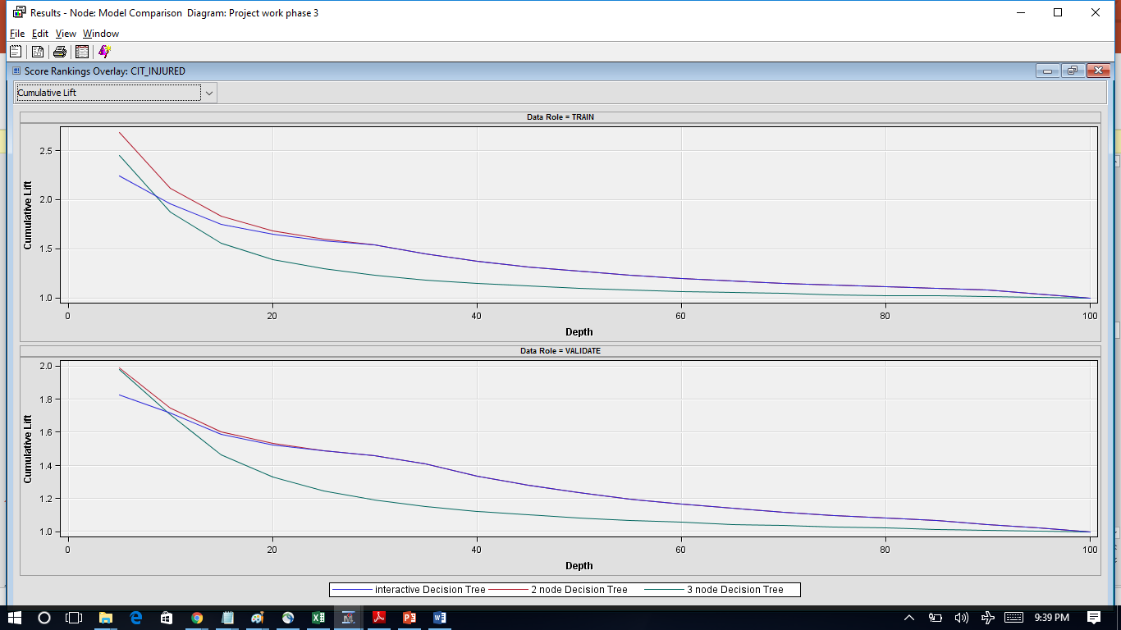
Model Comparison
Models | Avg Square Error | Misclassification Rate
Interactive Decision Tree | 0.1783 | 0.2569
2 Node Decision Tree | 0.1719 | 0.2502
3 Node Decision Tree | 0.1749 | 0.2480
Least Misclassification Rate
Hence best

Slide 11
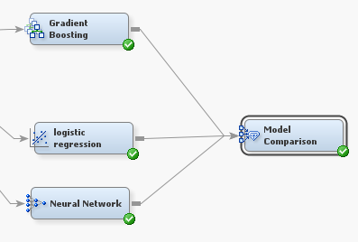
More Models: Logistic Regression, Neural Networks and Gradient Boosted Decision Tree

Slide 12
Model Comparison results:
Models | Avg Square Error | Misclassification Rate
Neural Network | 0.1739 | 0.268
Logical Regression | 0.1531 | 0.2436
Decision Tree with Gradient boosting | 0.187 | 0.2502
Least Misclassification Rate
Hence best
Based on the Data shared by the SAS Enterprise Miner, we can clearly say that Logistic Regression is the best fit as it has the least misclassification rate.

Slide 13
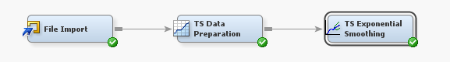
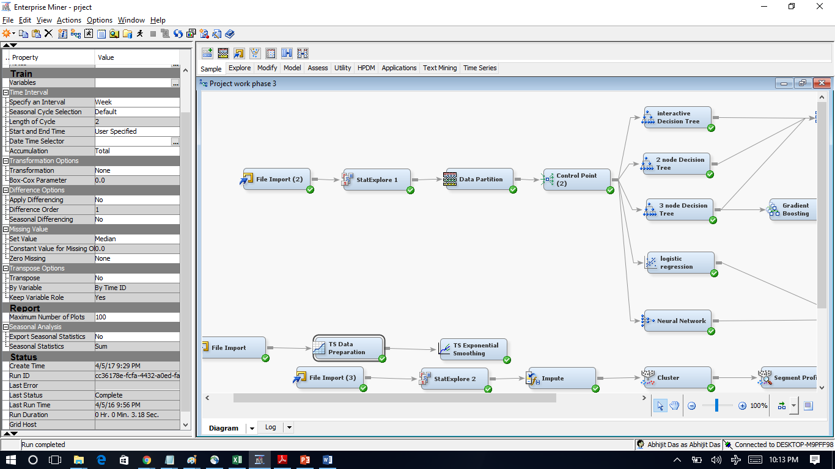
Time Series Analysis:
Variable | Role | Level
CURRENT_BADGE_NO | INPUT | INTERVAL
Coverted_OCCURRED_TM | INPUT | NOMINAL
OR_CODE | INPUT | INTERVAL
RA | INPUT | INTERVAL
Osex_Code | INPUT | INTERVAL
Force_Eff_code | INPUT | INTERVAL
C_Sex_Code | INPUT | INTERVAL
HIRE_DT | INPUT | INTERVAL
C_Infl_Ass_Code | INPUT | INTERVAL
C_Race_Code | INPUT | INTERVAL
CitNum | INPUT | INTERVAL
BEAT | INPUT | INTERVAL
UOF_Code | INPUT | INTERVAL
SECTOR | INPUT | INTERVAL
Cit_Chrg_Type_Code | INPUT | INTERVAL
Years_Service | INPUT | INTERVAL
OCCURRED_TM | INPUT | INTERVAL
C_ARR_CODE | TARGET | INTERVAL
Time series analysis is performed on interval data
Analyzed the data for the entire year week on week
Plot it graphically to predict the data for the coming weeks.

Slide 14
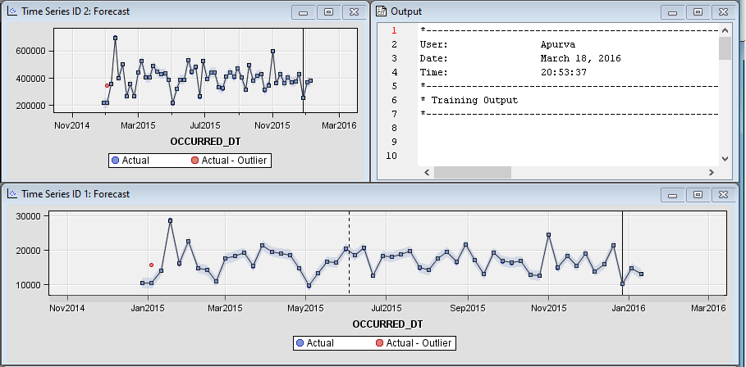
Findings from Time Series Analysis
Highest number of arrest occur during the spring season.
We see a rise in the rate of arrest during the holiday season and a dip in winters.

Slide 15
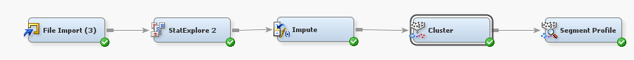
Clustering I Analysis:
Question : In which division at what time major interaction happen?
Stat Explorer
Impute Node
Cluster
Segment Profile---- Omkar to Explain

Slide 16
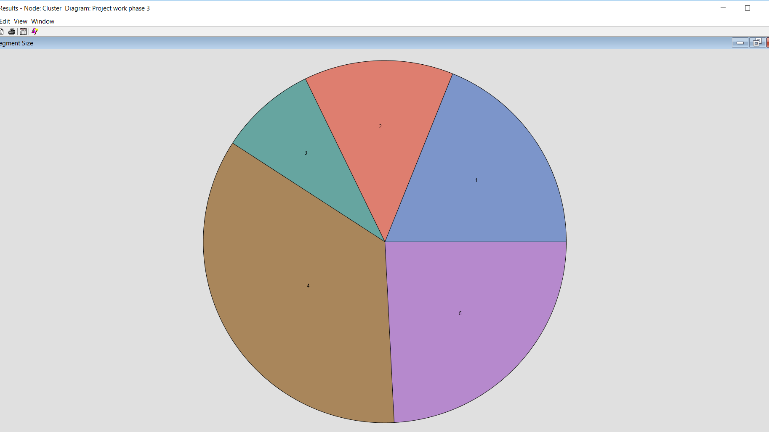
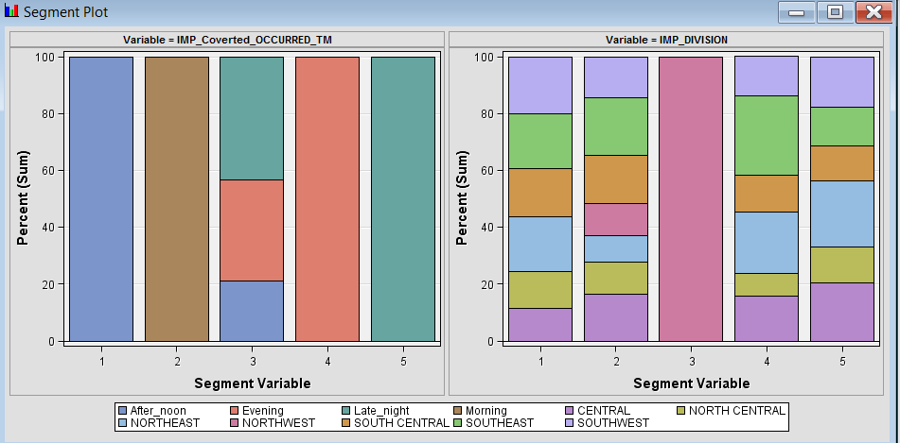
Clustering I Analysis Results:

Slide 17
Clustering I Analysis results:
The probability of interactions between police and citizens during evening is higher in Southeast.
The probability of interaction between police and citizens in the north east have a higher rate in late night.

Slide 18
Clustering II :
Question: General trend of encounters and effectively predict the risk behaviors ?
We have tasked clustering with grouping Citizen Sex, Citizen state assessment at the time of encounter, Citizen arrest and Citizen race to find out common traits within these attributes that lead to a citizen being arrested.
Input Variables: CitSex, CitRace, CIT_ARRESTED, CIT_INFL_ASSMT
As this is an unsupervised analysis technique we have set all the parameters to the input

Slide 19
Contd.

Slide 20
Clustering II - Statistics:

Slide 21
Clustering II Analysis Results:
If the accused is male, the probability of getting arrested during an encounter with police is higher.
Intoxication during the police interaction significantly increases the chance of the citizen getting arrested.
Further, an ethnic group(Black) has higher chances of getting arrested.

Slide 22
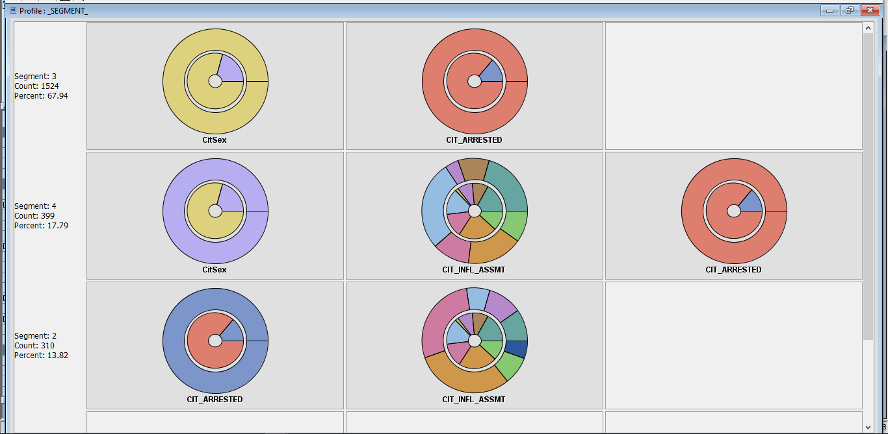
Clustering II Analysis- Segment profile:

Slide 23
Summary of Findings:
Almost 80% of the interactions between police and citizen will result in arrest of the citizen.
The Southeast area of the city and Northeast area of the city notch the highest number of interactions and hence arrests.
The Southeast is most susceptible area, 83% of the cases will result in arrests, followed by the Northeast region where, 79% of cases will result in arrest
Men have higher probability of being involved in interactions with cops- almost 77% of incidents recorded have a citizen whose gender is male.
For every injured citizen, there will be a 25% chance of the involved officer getting injured
It can be predicted that for the first 10 days for the following year there will be a minimum of 35 incidents and a maximum of 43 incidents

Slide 24
Managerial Implication:
As the Dallas police chief, more efforts should be focused on the Northeast and Southwest areas of the city.
Increased patrolling during evening will make these areas safer.
A part of budget maybe allocated for special training to avoid possible injuries to officers during the interaction.

Slide 25
QUESTIONS ?

